Slide 1

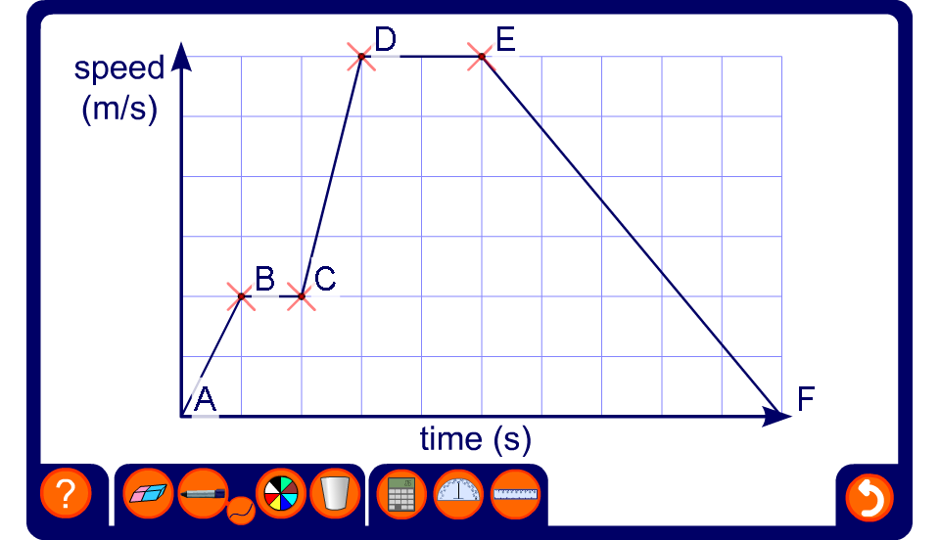


Interpreting speed-time graphs
Notes:
Move the points to change the graph and ask pupils to interpret it. For example, ask pupils to calculate the acceleration and distance travelled over various stages in the journey.
Ask pupils to find the total distance travelled by finding the area under the graph.
Ask pupils to make up a story for a given graph.

